Slide 1
Framework for establishing and promoting RPCM

Slide 2
Tentative Table of Contents
Defining culture and terminology
What is safety culture /attributes of safety culture
Radiation safety culture _ionizing only
Current trends and need for actions in health care; trends on dose_ include technology and modalities, hybrid
Need and Motivation for this document
Links with previous initiatives: BSS, IRPA Guiding Principles & Bonn Call to Action etc:::FORO
Scope and Target audience

Slide 3
Chapter 2
2. Radiation? Safety culture in health care
Specific considerations applicable in medical settings
Identifying stakeholders to build and maintain a RSCM or RPCM
Challenges in RSC: May also consider specific examples of modalities
To pick up points from Workshop

Slide 4
Chapter 3
Radiation Safety culture in healthcare as a part of organizational management
International guidelines
Roles & responsibilities
Summary of Workshop

Slide 5
Chapter 4
4. Tools for establishing and maintaining radiation safety culture in healthcare
Policy statements
Standards and regulations
Role of voluntary actions
Communications (Posters, flyers,…)
Audit activities
Education &training of various staff groups
Research

Slide 6
Chapter 5
5. Assessment of radiation safety culture /safety assessment in healthcare
Tools for assessing RSC HC
Indicators of the level of RSC HC
Audit of RSC HC
Keep in mind concerns of ,manufacturers
Best level and achievable levels

Slide 7
Chapter 6 and 7
Examples of good and bad practices to foster RS culture in health care related to tools,
Learning outcomes from these examples
Different scenarios & modalities (e.g. radiology departments, interventional radiology operating rooms, teletherapy and brachytherapy services, nuclear medicine departments, dental facilities, use of radiation outside the radiology department, places where referring physicians work, medical schools, other settings/scenarios)
what to do (issues)
what was done (actions)
what was achieved (results)
Also add challenges in specific situation
Chapter 7: Conclusions

Slide 8
Appendices
Appendix 1: Abbreviations
Appendix 2: Glossary
Appendix 3: References
Appendix 4: Resources to learn more
Other/s ??
Comparisons between safety culture and radiation safety, if not adequately covered in chap 1

Slide 9
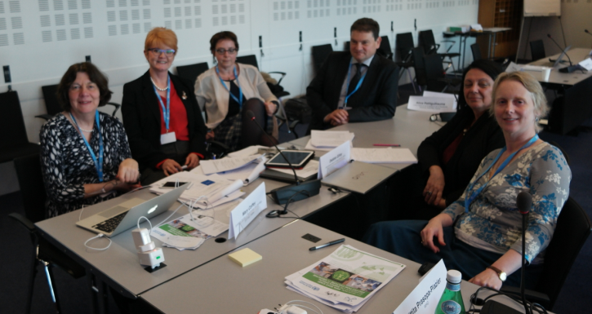
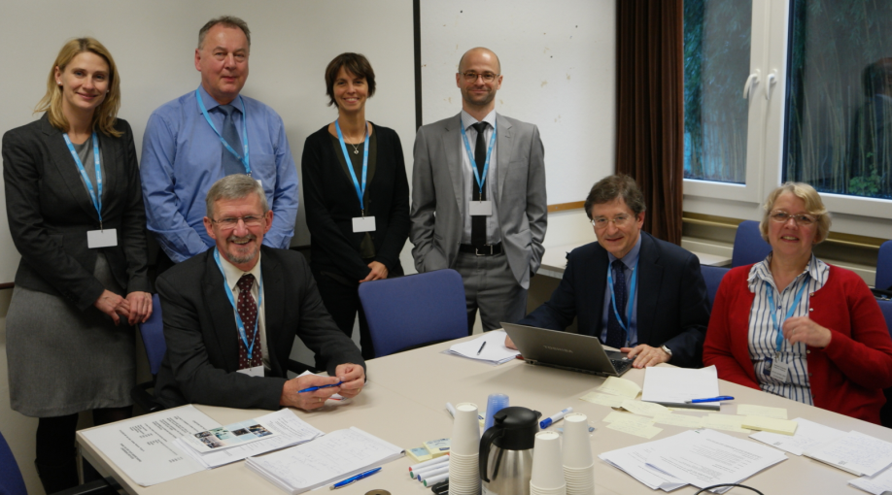
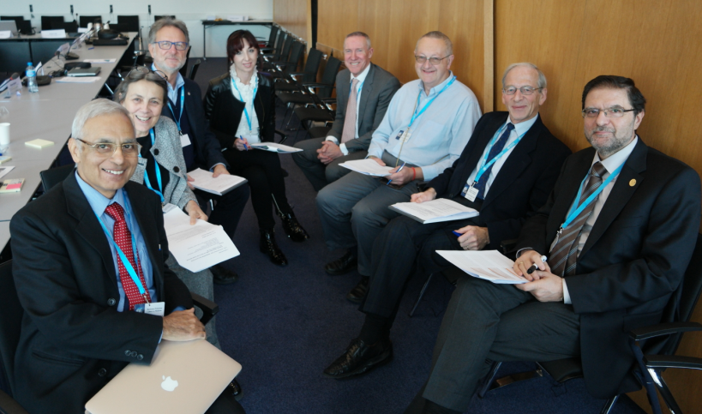
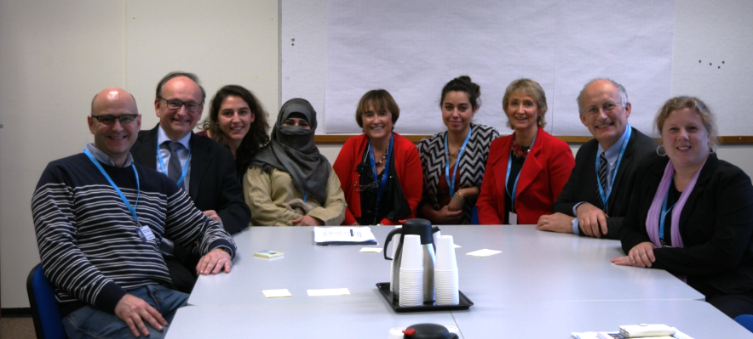
The dream team

